Slide 1
Dominating Sets

Slide 2
Overview
A subset of the vertices of a graph is a dominating set if every vertex not in the subset is adjacent to at least one vertex in this subset. Dominating sets are widely used for clustering and routing in ad hoc wireless networks.
In this chapter, we describe sample sequential, distributed, and self-stabilizing dominating set algorithms.

Slide 3
Definition 11.1 Given a graph G(V,E), a Dominating Set (DS) is the set of vertices V’∈ V such that any vertex v ∈ V is either in V’ or a neighbor of a vertex in V’.
Alternatively, for all v ∈ (V − V’) , v is a neighbor to at least one node in V’ .
Therefore, every MIS is a DS. However, every DS is not a MIS since some vertices of a DS may be neighbors.

Slide 4
Definition 11.2 (Minimum and minimal dominating sets) A dominating set is minimum (MinDS) if it has the smallest cardinality among all possible dominating sets of the graph G.
A dominating set is minimal (MDS) if it is not contained in any other dominating sets of G.
Finding a minimum sized dominating set is NP-hard.

Slide 5
Definition 11.3 (Connected Dominating Set) A Connected Dominating Set (CDS) of a graph G is a dominating set that induces a connected subgraph in G.
The Minimum Connected Dominating Set (MinCDS ) is a connected dominating set with the minimum size, and finding MinCDS is NP-hard. The Minimal Connected Dominating Set (MCDS ) is a CDS that is not contained in any other CDS of G ..

Slide 6
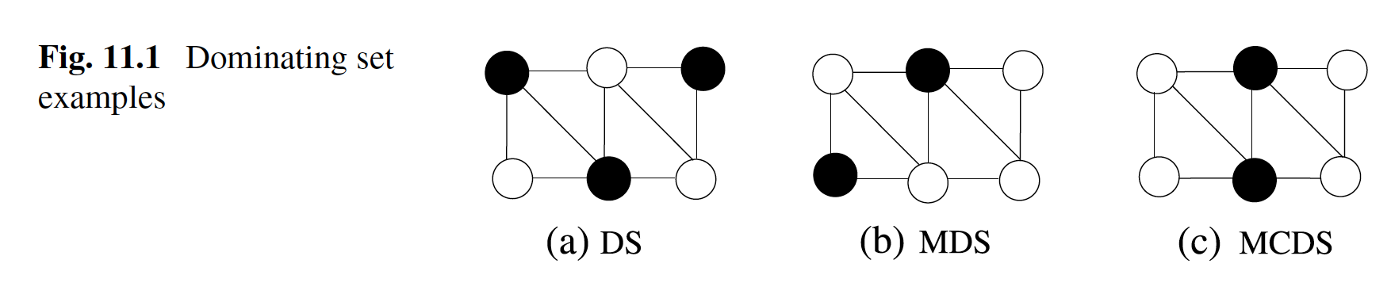

Slide 7
Sequential Algorithms
Greedy Sequential MDS Algorithm
The first greedy sequential algorithm finds an MDS by always selecting nodes that have the greatest number of neighbors that do not dominate or are not dominated.
We will assume that the nodes in the MDS are colored black, their neighbors are colored gray, and any node that has not been a dominator or dominated is colored white.
Notes:
The span of a node is defined as the number of white nodes it has, including
itself. The Seq _MDS algorithm initially colors all vertices of the graph white. At each iteration it then picks the vertex u with the highest span and colors it black to
include it in the DS. It also colors all the neighbors of u gray in this iteration, and vertex u is then excluded from the search list.
This process is continued until there are no white colored vertices left.

Slide 8
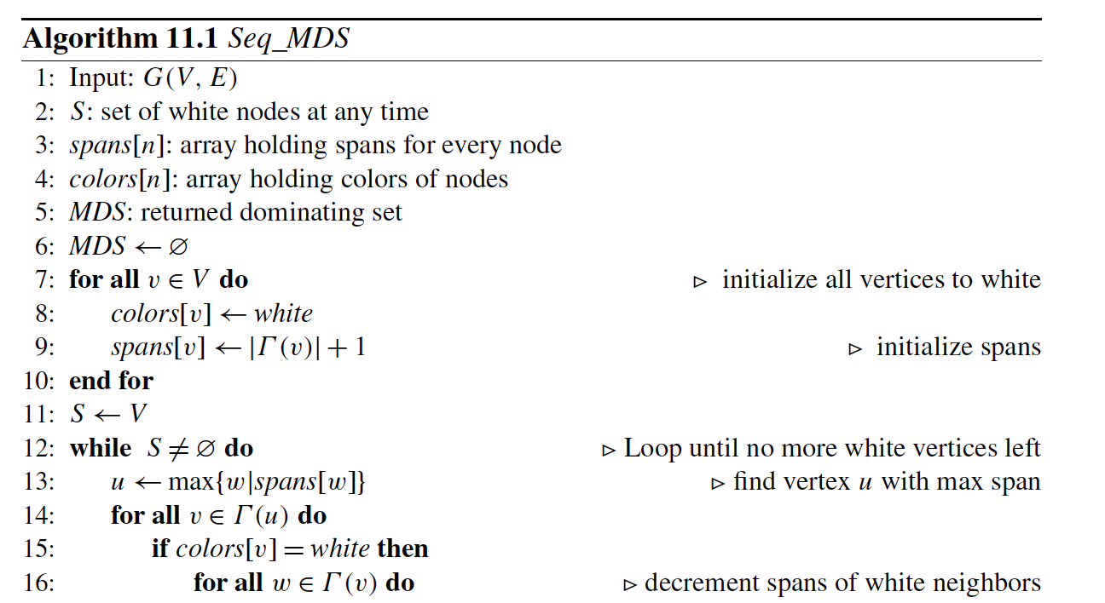

Slide 9
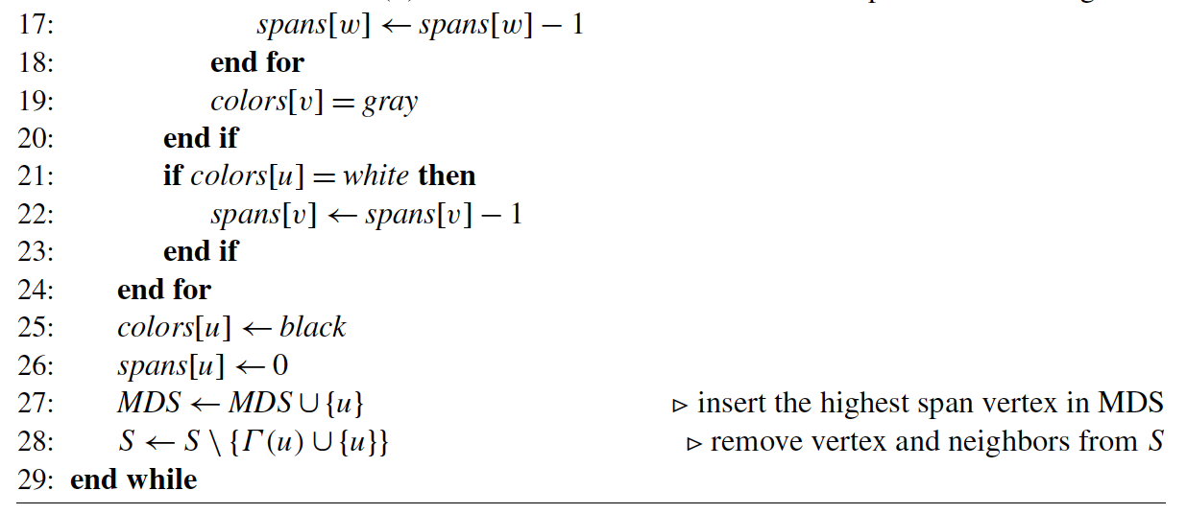

Slide 10
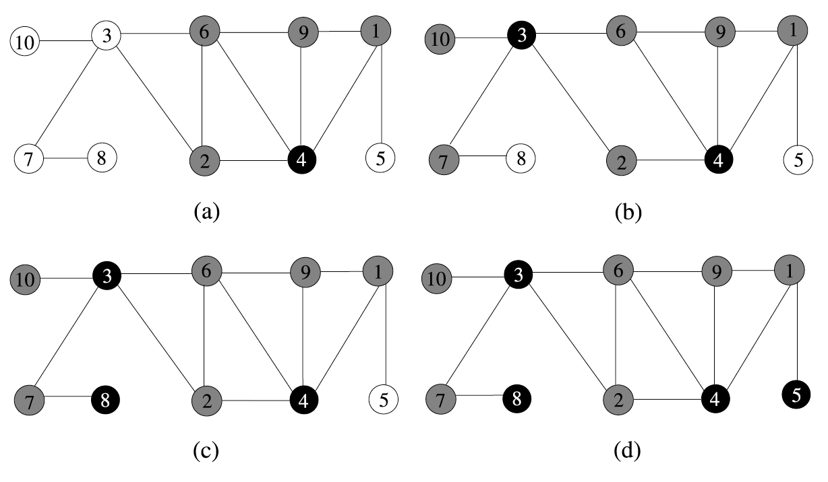
Greedy Sequantial Example

Slide 11
Greedy Sequential MCDS Algorithm
The second version of greedy algorithm finds an MCDS by a simple modification. Instead of choosing any vertex with the highest span, whether it is a white or gray node, we choose a gray vertex with the highest span.
As a gray node will be adjacent to a black node, this algorithm will add a black node next to at least one other node in each iteration; therefore the output will be an MCDS.
Notes:
Greedy Sequential MCDS Algorithm

Slide 12
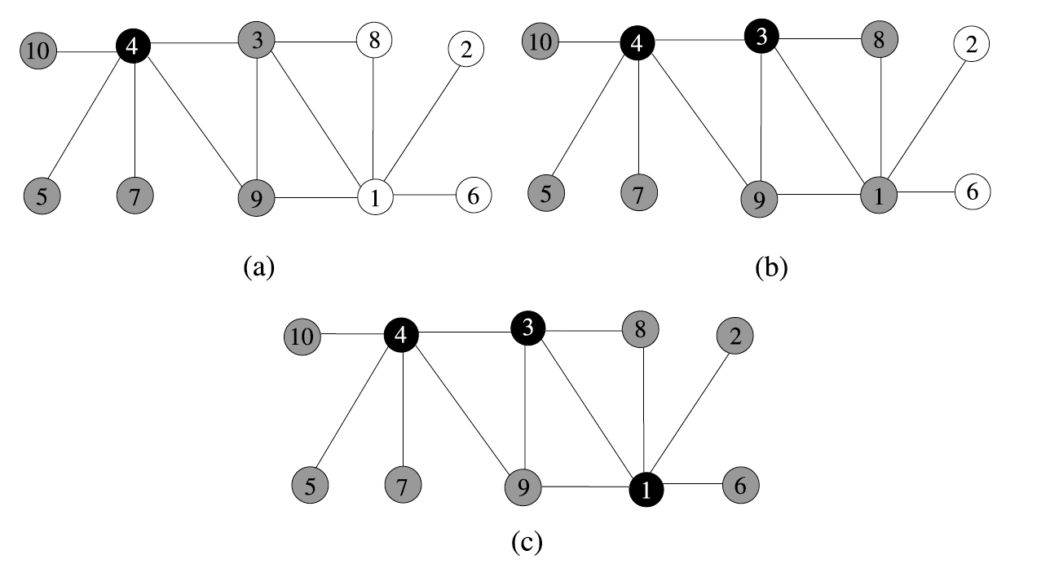

Slide 13
Guha-Khuller Algorithms
Guha and Khuller provided two greedy sequential algorithms to construct CDS in arbitrary graphs.
In their first algorithm, a CDS is grown iteratively from a single node.
In the second algorithm, a WCDS is first formed and then the intermediate nodes are connected.
These algorithms have formed the basis for other distributed MCDS algorithms and we will describe them next.

Slide 14
Guha-Khuller – The First Algorithm
This algorithm provides an improvement ove seq CDS by the addition of a simple heuristic.
It starts by coloring all the vertices of the graph G(V,E) white, and it first selects the vertex with the highest degree, colors it black, and all its neighbors are colored gray.
The algorithm then scans all the gray nodes and their white neighbors by finding the number of white neighbors of gray nodes and the white neighbors of their neighbors.

Slide 15
Guha-Khuller – The First Algorithm
It then selects a gray node or a pair consisting of a gray node and a white node, whichever gives the highest number of white neighbors.
It colors the selected gray node or the selected pair of gray and white node black and starts with the next iteration. This process continues until all the nodes are colored black or gray.

Slide 16
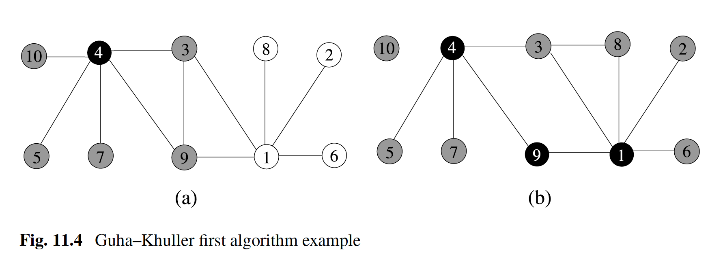
Notes:
Figure 11.4 displays the operation of this algorithm in the same sample graph of
Fig. 11.3 . Node 4 is first selected; it is colored black, and all of its neighbors are
colored gray as shown in (a). Then, all gray neighbors and their white neighbors are
searched, and the node pair 9, 1 (or the pair 3, 1 ) has the highest number of white
neighbors, both are colored black, and their neighbors are colored gray as shown in
(b), which completes the construction of the CDS consisting of nodes 4, 9, and 1.

Slide 17
Guha-Khuller – The First Algorithm
It was shown in [4 ] that this algorithm has an approximation ratio of 2( 1 +H(Δ)) , where H is the Harmonic Function.

Slide 18
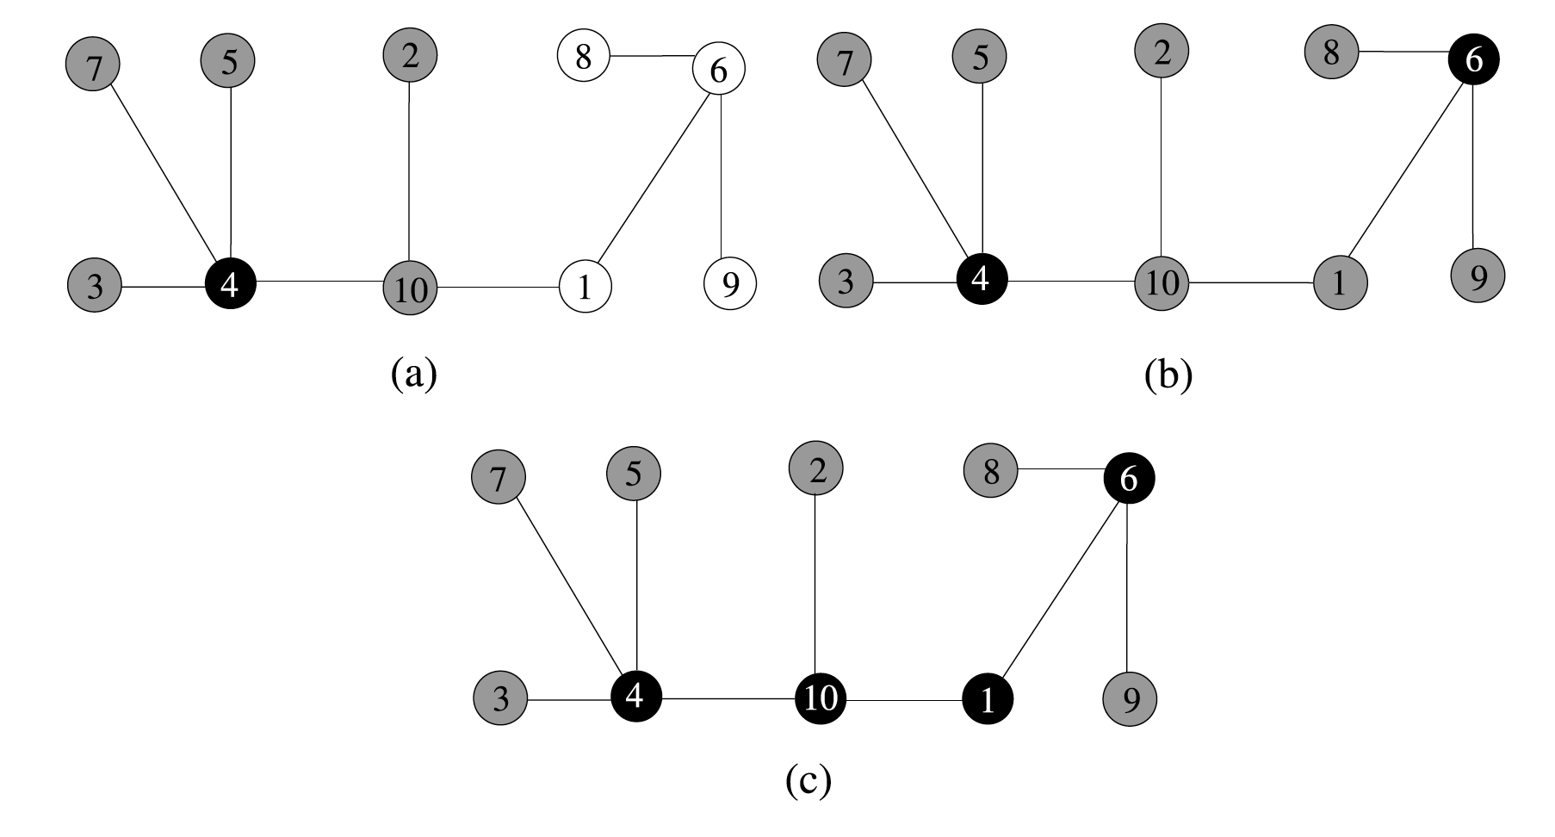
Guha-Khuller – The Second Algorithm

Slide 19
Guha-Khuller – The Second Algorithm
The second algotithm starts by coloring all node white as before.
A piece in this algorithm is defined as either connected black component or a white node.
The algorithm consist of two phases: In the first phase a node that casuses greatest reduction in the number of pieces in the graph selected and colored black and all of its neighbors are colored gray.

Slide 20
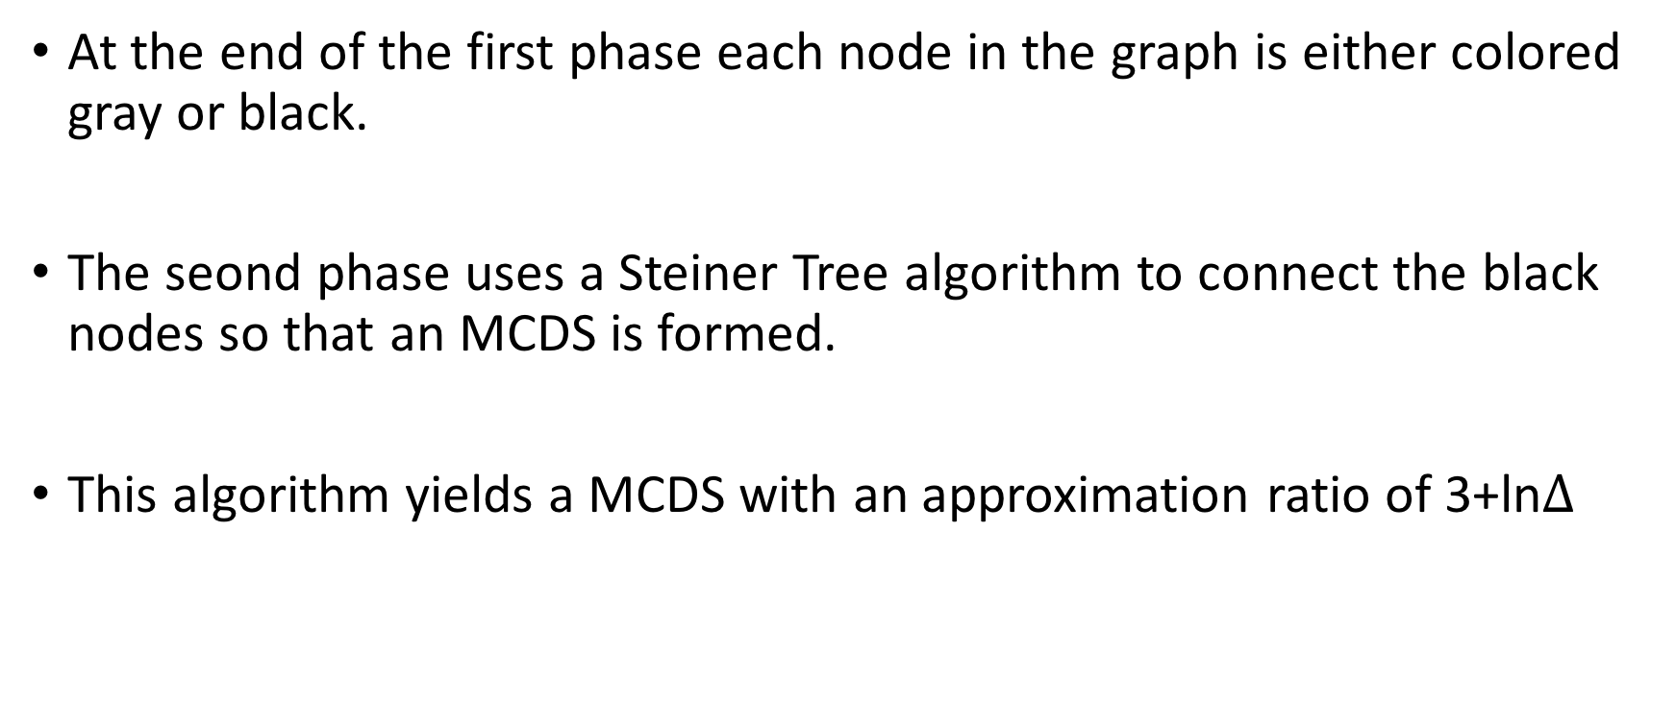
Guha-Khuller – The Second Algorithm
At the end of the first phase each node in the graph is either colored gray or black.
The seond phase uses a Steiner Tree algorithm to connect the black nodes so that an MCDS is formed.
This algorithm yields a MCDS with an approximation ratio of 3+ln$Δ$

Slide 21
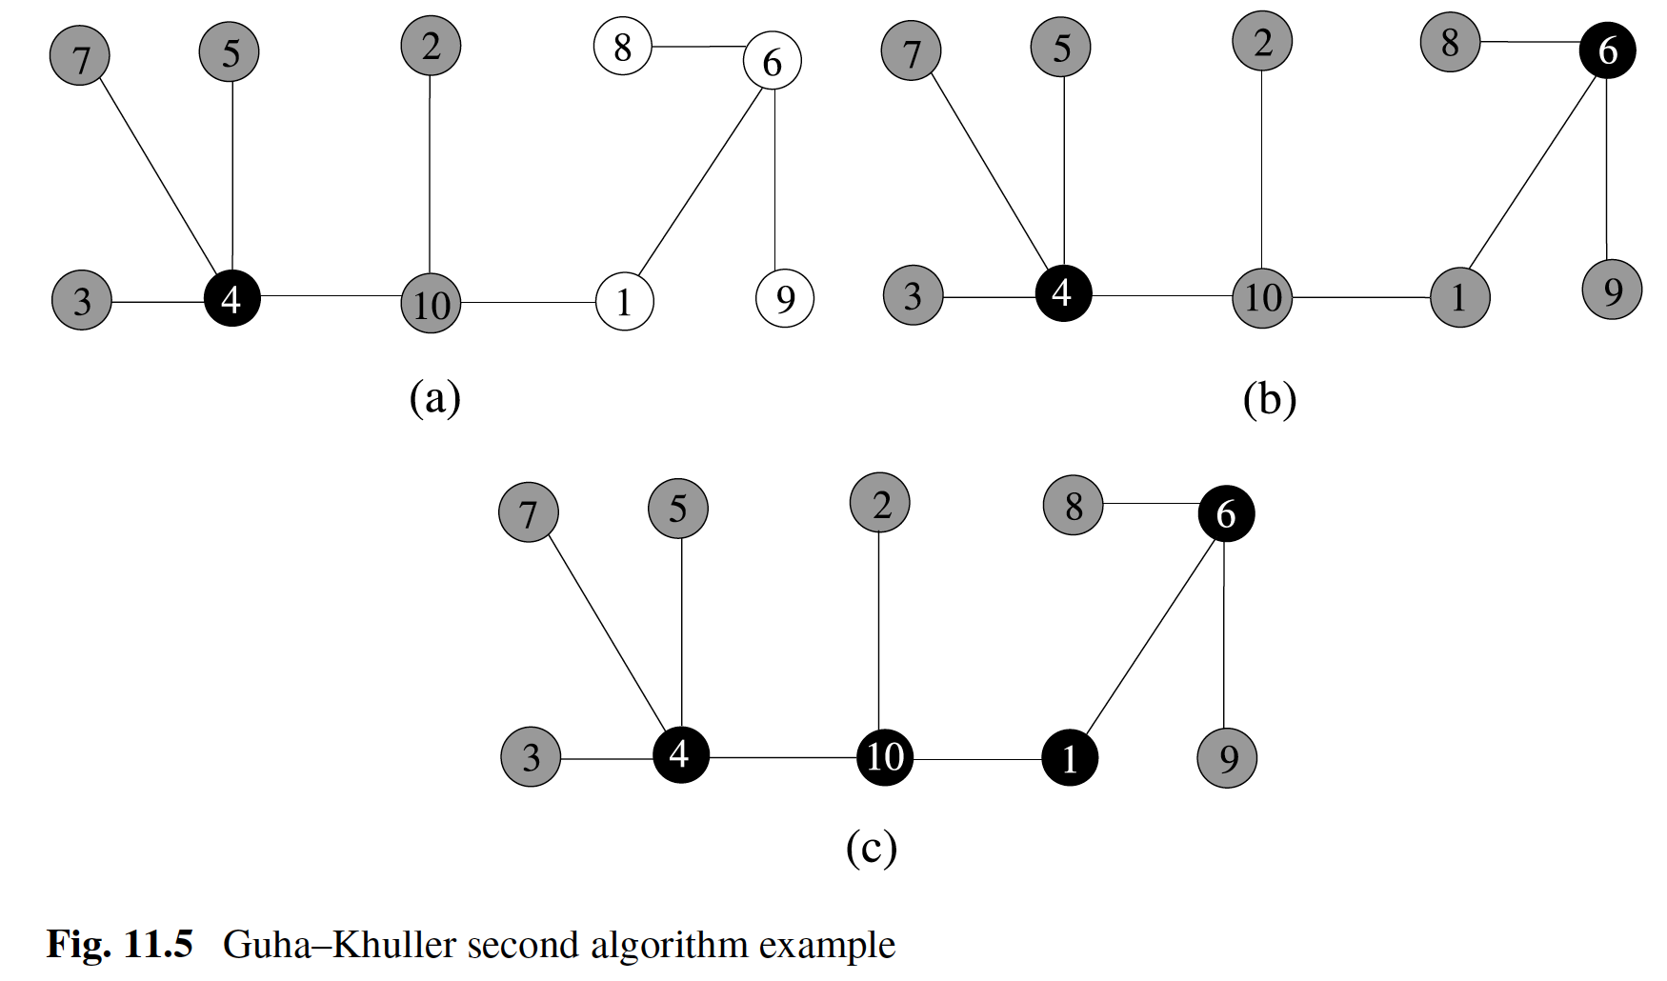
Guha-Khuller – The Second Algorithm

Slide 22
Distributed Algorithms
We will first explore the possibility of obtaining a distributed algorithm fom the sequential algorithm Seq_MDS where a node with the hishest span is colored black in each iteration.
In the synchronous implementation a node that finds it has the highest span among neighgbors, colors itself black and the neighbors colors themselves gray in each round.

Slide 23
Distributed Algorithms
The messages used are described below:
ch_black: A node that has the highest span locally, sends this message to current active neighbors.
undecide: A node that does not have the highest span locally, sends this message to current active neighbors.
ch_gray: A node that changes its color from white to gray sends this message to current active neighbors so that they decrement their spans.

Slide 24
Distributed Algorithms
The messages used are described below:
no_change: If a white node does not change its color in a round , it sends this message to current active neighbors .
The undecide and no_change messages are needed for sychnronization. In the design we propose each round consists of two phases.

Slide 25
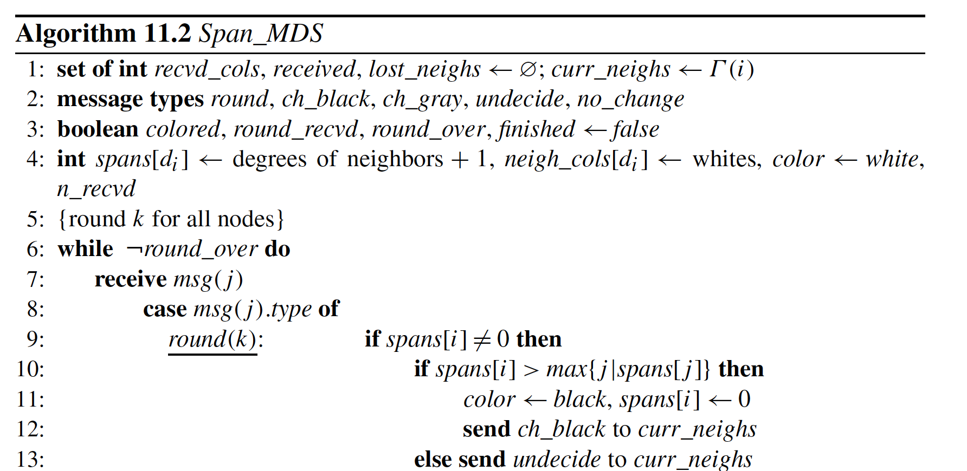

Slide 26
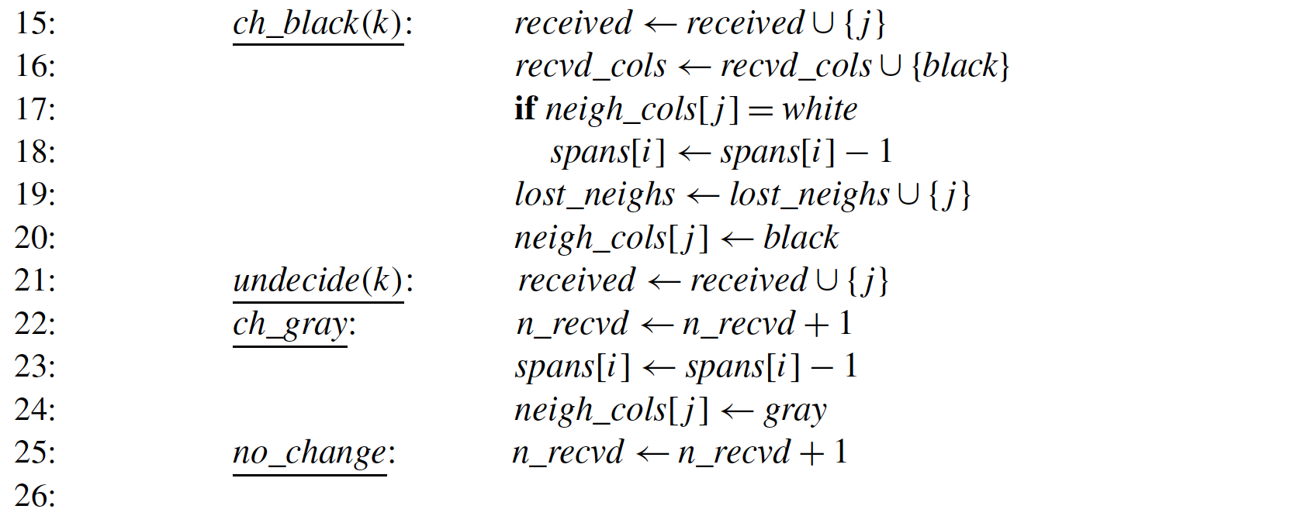

Slide 27
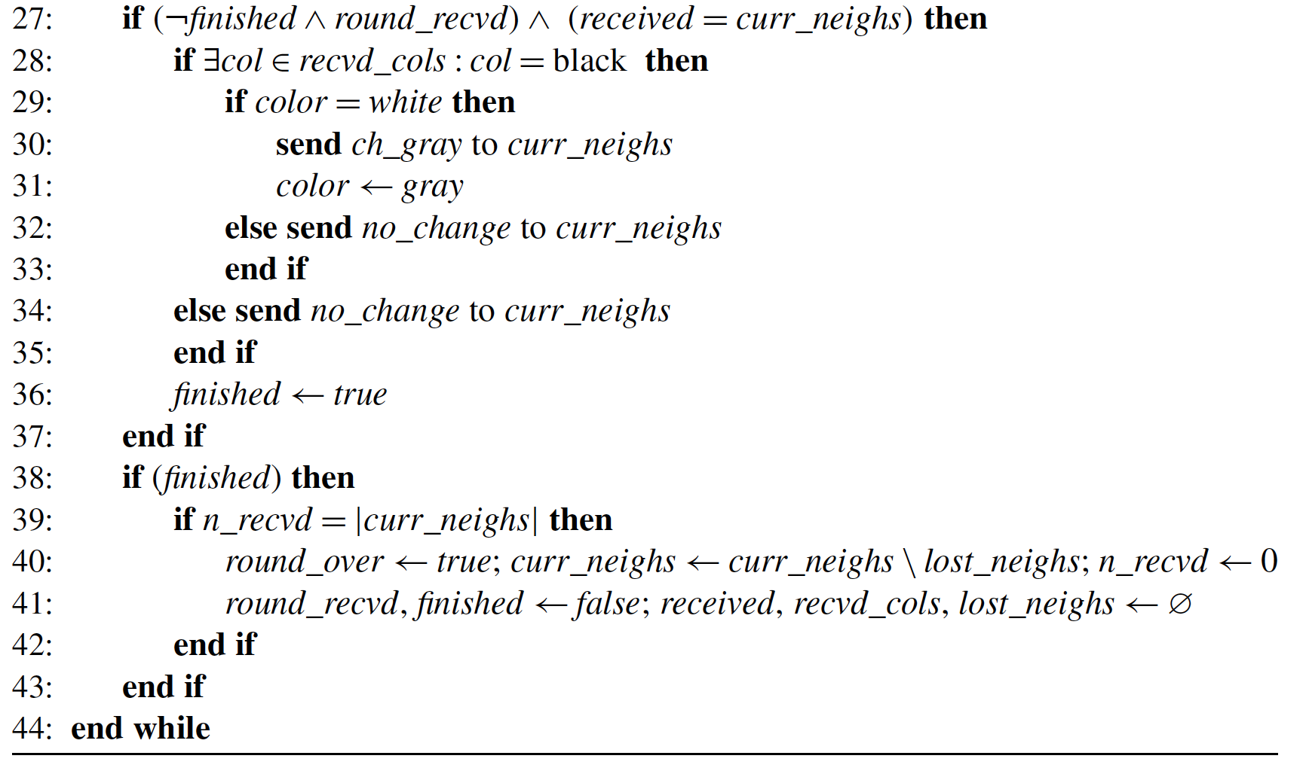

Slide 28
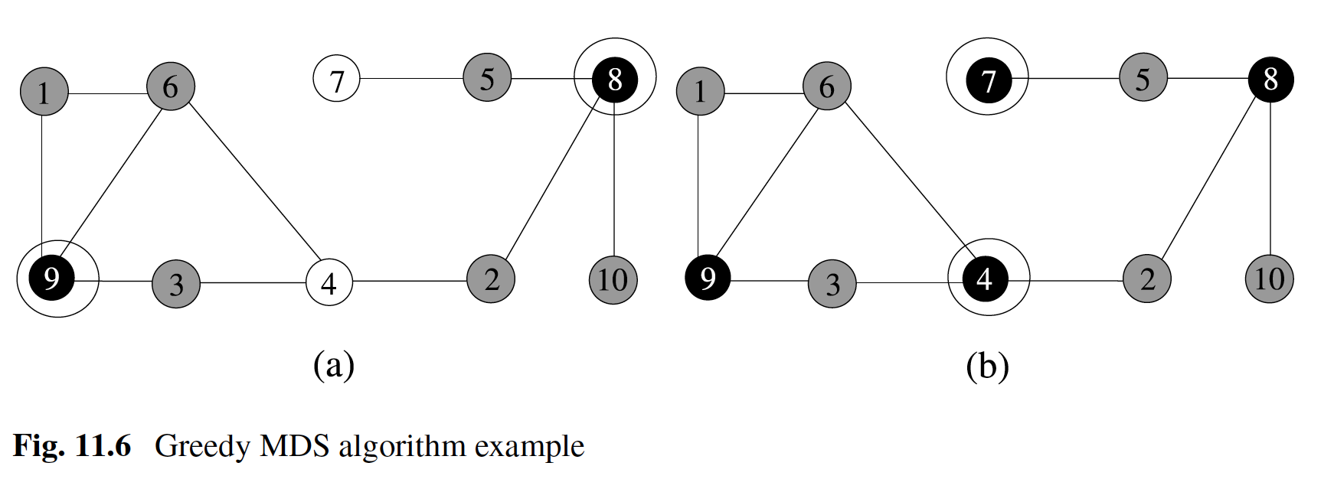
Span MDS

